Slide 1

Introduction to Software Engineering (ISE102) Tutorial Week 2

Slide 2
Classes and Objects
What is a Class?
A class is a blueprint for creating objects.
It defines attributes (data) and methods (behaviours).
Class names are nouns (e.g., Student, Account, CreditCard).

Slide 3
Classes and Objects
What is an Object?
An object is a real-world instance of a class.
Objects exist at runtime and store their own data.

Slide 4
Classes and Objects
Real-World Analogy:
Class = Recipe
Object = Cake made using that recipe
Australian Example:
Class: Koala
Object: A koala named “Koko” at Taronga Zoo

Slide 5
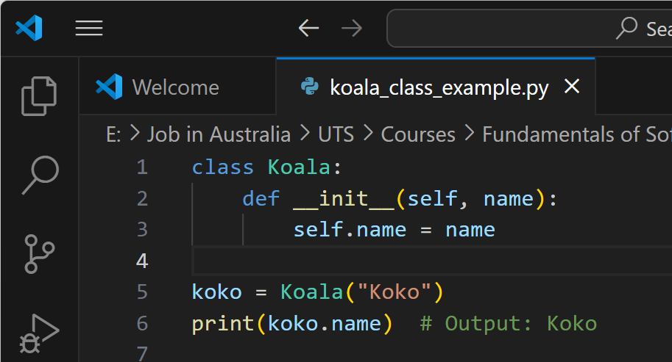
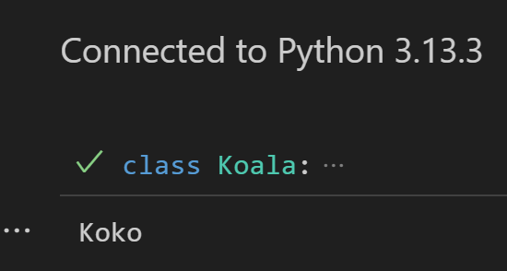
Koala Class Example in Python
This code defines a class called Koala with a name attribute. It then creates an object koko from the class and prints its name.

Slide 6
Activity 1: Add a New Attribute and Print It
Task: Modify the Koala class to include an additional attribute called age. When creating a koala object, assign both name and age, and then print both.
class Koala:
def __init__(self, name, age):
self.name = name
self.age = age
koko = Koala("Koko", 4)
print(f"Name: {koko.name}, Age: {koko.age}")
Learning Outcome: Understanding how to add and initialize multiple attributes.

Slide 7
Activity 2: Add a Method to Display a Greeting
Task: Add a method to the Koala class called greet() that prints a custom message using the koala’s name. Then call this method on an object.
class Koala:
def __init__(self, name):
self.name = name
def greet(self):
print(f"G'day! I'm {self.name}, the koala.")
koko = Koala("Koko")
koko.greet()
Learning Outcome: Understanding how to define and use instance methods.

Slide 8
Object-Oriented Paradigm Principles
What is OOP?
It’s a way of writing code by thinking in terms of real-world objects.
These objects can have data (like properties) and actions (like behaviours).
OOP helps us build programs that are easier to understand and maintain.

Slide 9
Object-Oriented Paradigm Principles
4 Main Ideas in OOP (AEIP)
Principle | What it Means (Simple) | Real-Life Example
Abstraction | Hide the messy stuff and show only the basics | Coffee machine – you press a button, not worry how it works
Encapsulation | Lock the data inside and control who sees or changes it | Medicine sealed in a capsule
Inheritance | Share code from one class to another | Kids inherit their parents’ eye colour
Polymorphism | One word, different actions depending on the object | “Play” button on Spotify vs. radio

Slide 10
Abstraction
What is Abstraction?
It means hiding the complicated parts of something.
You only show what’s needed, not how it works inside.
It helps people use things easily without getting confused by the details

Slide 11
Abstraction
Two Types of Abstraction:
Data abstraction → Hide the variable itself, just show the value (e.g., you see your bank balance, not how it's stored in code)
Function abstraction → Hide the code, just use the function (e.g., use withdraw() without seeing how it works inside)

Slide 12
Abstraction
Real-World Example (Australia):
When you use an ATM, you don’t care how it connects to your bank. You just enter your PIN, choose an amount, and get your cash. That’s abstraction — using it without knowing the details.

Slide 13
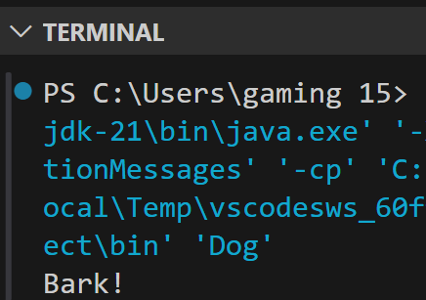
Using Abstraction in Java with Animal Example
abstract class Animal {
abstract void makeSound();
} class Dog extends Animal {
void makeSound() {
System.out.println("Bark!");
}
public static void main(String[] args) {
Dog dog = new Dog(); // Create an object of Dog
dog.makeSound(); // Call the method
}
}
This code shows how abstraction works in Java using an abstract class called Animal.
The Dog class extends Animal and provides its own version of the makeSound() method. The main() method creates a Dog object and calls its sound method to print "Bark!".

Slide 14
Using Abstraction in Java with Animal Example
abstract class Animal {
abstract void makeSound();
} class Dog extends Animal {
void makeSound() {
System.out.println("Bark!");
}
public static void main(String[] args) {
Dog dog = new Dog(); // Create an object of Dog
dog.makeSound(); // Call the method
}
}
In short: It hides the general idea (makeSound) in the Animal class and lets the Dog class decide how to make the sound — this is abstraction in action.

Slide 15
Encapsulation
What is Encapsulation?
Put data and functions together in one class
Hide the details (like private variables)
Let other parts of the program access the data safely using public methods
Keeps things safe, simple, and easy to manage

Slide 16
Encapsulation
Real-Life Analogy:
A capsule pill hides the medicine inside. You can take it, but not open or change it.
Australian Example:
You can see your Opal card balance — but you can't change the balance yourself.

Slide 17
Encapsulation Example Account in Python
class Account:
def __init__(self, balance):
self.__balance = balance # Hidden (private)
def get_balance(self):
return self.__balance # Safe way to access balance
This code shows encapsulation by keeping the balance private and allowing access through a safe get_balance() method.

Slide 18
Inheritance
What is Inheritance?
One class gets features (methods and variables) from another
Helps you reuse code instead of writing it again
Makes programs easier to manage and extend

Slide 19
Inheritance
Real-Life Analogy:
A Cashier is a Person. A Manager is also a Person. They all share things like name and age but have their own tasks too.
Rules:
A child class can use everything from its parent class
It can also change or add its own methods

Slide 20
Inheritance kangaroo example in Java
class Animal {
void eat() {
System.out.println("Eating...");
}
}
class Kangaroo extends Animal {
void jump() {
System.out.println("Jumping...");
}
}
This Java code shows inheritance, where Kangaroo inherits the eat() method from the Animal class and adds its own jump() method.

Slide 21
Inheritance kangaroo example in Java
class Animal {
void eat() {
System.out.println("Eating...");
}
}
class Kangaroo extends Animal {
void jump() {
System.out.println("Jumping...");
}
}
This code defines the classes, but does not run anything because there’s no main() method.

Slide 22
Inheritance kangaroo example in Java
public class Main {
public static void main(String[] args) {
Kangaroo k = new Kangaroo();
k.eat();
k.jump();
}
}
To Produce Output, Add a main() Method:

Slide 23
UML Class Diagram for the Java inheritance example with Animal and Kangaroo
Animal
In UML class diagrams, it is better to include the method name, its parameters, and its return type using this format:
Animal is the parent (superclass)
Kangaroo is the child (subclass) and inherits the eat() method
Kangaroo also has its own method jump()
+ eat (): void
+ methodName(parameterList): returnType
Kangaroo
So we write
+ jump(): void
+ jump (): void

Slide 24
UML Class Diagram for the Java inheritance example with Animal and Kangaroo
Animal
Same for eat():
It just prints "Eating...", it doesn’t return anything.
So we label it void (same as in Java code).
It means:
+ → The method is public (accessible from outside the class)
jump() → This is the method name with no parameters
void → The method does not return any value
+ eat (): void
+ methodName(parameterList): returnType
Kangaroo
So we write
+ jump(): void
+ jump (): void

Slide 25
UML Class Diagram for the Java inheritance example with Animal and Kangaroo
Animal
Summary: We use void in UML for the same reason we use it in Java — to show that the method does something but does not give anything back (like a number or string).
+ eat (): void
Kangaroo
+ jump (): void

Slide 26
Key Differences in UML When Representing Python
The structure of a UML class diagram is the same, whether we're using Java, Python, or another object-oriented language.
Key differences in UML when representing Python:
Feature | Java Style | Python Style
Access modifiers | + (public), - (private), # (protected) | Python has no true enforcement — use _ (protected), __ (private by convention)
Return types | Required (e.g., : void, : int) | Optional — Python is dynamically typed
Constructor name | ClassName() | __init__()
Static vs instance | Explicit in Java (static) | Not shown in UML for Python unless needed

Slide 27
UML Class Diagram (Python-style, simplified)
Animal
UML diagrams work across all languages
You can keep using the same diagrams for Python, just ignore strict return types or access modifiers
Use __init__() to represent constructors in Python
+ eat ()
Kangaroo
+ jump ()

Slide 28
Polymorphism
What is Polymorphism?
One function, many behaviours
The same method name does different things depending on which object calls it
Helps write flexible and reusable code

Slide 29
Polymorphism
Real-Life Analogy:
You say “Open” — a fridge, a file, and a door will all open, but in different ways
Australian Example:
The method calculateInterest() gives different results for:
A MyGov savings account
A Centrelink credit benefit

Slide 30
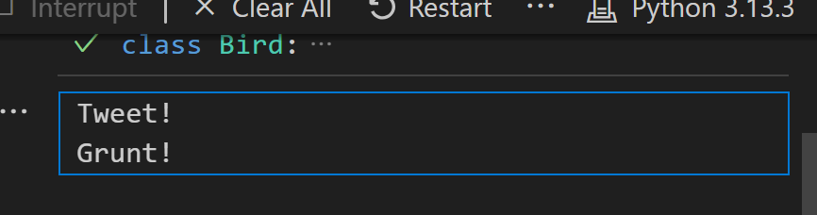
Polymorphism Bird Example in Python
class Bird:
def make_sound(self):
print("Tweet!")
class Emu(Bird):
def make_sound(self):
print("Grunt!")
def speak(bird):
bird.make_sound()
speak(Bird()) # Output: Tweet!
speak(Emu()) # Output: Grunt!
This Python code shows polymorphism, where different bird objects respond to the same make_sound() method in their own unique way.

Slide 31
Object-Oriented Design (OOD)
What is OOD?
It’s how we plan software using objects, their data, and their actions
Helps make code easier to build, test, and maintain

Slide 32
Object-Oriented Design (OOD)
Key Steps:
Find the classes (from real use cases)
List their attributes (nouns) and methods (verbs)
Show how they relate
Draw a UML class diagram

Slide 33
Object-Oriented Design (OOD)
Australian Example:
Designing a MyGov login system:
Classes: User, Account, Authenticator
Methods: login(), validateOTP()
"A Customer uses the deposit() method, but it's defined in the Account class."

Slide 34
Object-Oriented Design (OOD)
Australian Example:
Designing a MyGov login system:
Classes: User, Account, Authenticator
Methods: login(), validateOTP()
"A Customer uses the deposit() method, but it's defined in the Account class."

Slide 35
Understanding UML Class Diagrams (Account Example) – Java Style Notation
What is UML?
UML = Unified Modeling Language
Used to draw diagrams that show how classes are built and how they relate
Account
- balance: double
- ownerName: String
- means private
+ means public
+ deposit(): void
+ withdraw(): void

Slide 36
Recommended Tools for Drawing UML Diagrams
Tools You Can Use:
Draw.io
Visual Paradigm (free)
Lucidchart
Microsoft Visio
These tools help you create class diagrams, use case diagrams, and more—free and beginner-friendly.

Slide 37
Tool | Description | Platform | Best For | Link
Draw.io (diagrams.net) | Intuitive, browser-based diagramming tool with UML templates. | Web, Desktop | Class Diagrams, Use Case Diagrams, Flowcharts | https://draw.io
Lucidchart (Free Plan) | Easy-to-use interface with real-time collaboration and UML templates. | Web | UML diagrams, Use Case design, Group work | https://www.lucidchart.com
Visual Paradigm (Community Edition) | Professional UML and system modeling tool with rich diagram support. | Desktop (Windows/macOS/Linux) | Class Diagrams, Sequence Diagrams, DFDs | https://www.visual-paradigm.com/download/community.jsp
StarUML (Free Trial or License) | Designed for software engineering students and professionals. | Desktop | Full UML diagram suite (recommended in course) | https://staruml.io
Creately (Free Tier) | Collaborative visual workspace with multiple UML templates. | Web | Use Cases, Class Diagrams, ERDs | https://creately.com

Slide 38
Recommendation for Students
Beginner-friendly: Start with Draw.io or Lucidchart.
Professional-level UML modelling: Use StarUML or Visual Paradigm.
Offline work: Prefer Visual Paradigm or StarUML desktop versions.
Collaboration features: Use Lucidchart or Creately (great for group projects).

Slide 39
Using Microsoft Visio for UML Diagrams
Microsoft Visio is a powerful diagramming tool that can be used to draw a variety of system and software models, including UML diagrams.
Is Visio Suitable for This Unit?
Yes — Visio is suitable for creating:
Use Case Diagrams
Class Diagrams
Activity Diagrams
Sequence Diagrams

Slide 40
Using Microsoft Visio for UML Diagrams
However, please note:
Feature | Details
Installation | Part of Microsoft 365 (Pro Plus or Enterprise editions)
License | May require separate license or institutional access
Suitability for Beginners | Moderate (not as intuitive as Draw.io or StarUML)
Export Options | Easily export to PDF or image formats
UML Templates | Available via built-in or downloadable stencils

Slide 41
Using Microsoft Visio for UML Diagrams
Recommendation:
While Visio can be used effectively, we recommend free and lightweight tools such as:
StarUML (for offline UML support)
Draw.io (diagrams.net) (for browser-based drawing)
If you already have access to Microsoft Visio and are comfortable using it, you are welcome to use it for your assignments in this unit.

Slide 42
Using Microsoft Visio for UML Diagrams
If your university provides Microsoft 365 for Education:
Visit your university's Office 365 portal, e.g. https://www.office.com
Sign in using your University email.
Click on "Install Office".
If Visio is included in your license, you will see an option to install Visio under “Other installs”.
Not all student accounts include Visio by default. Check with your university IT or library services.

Slide 43
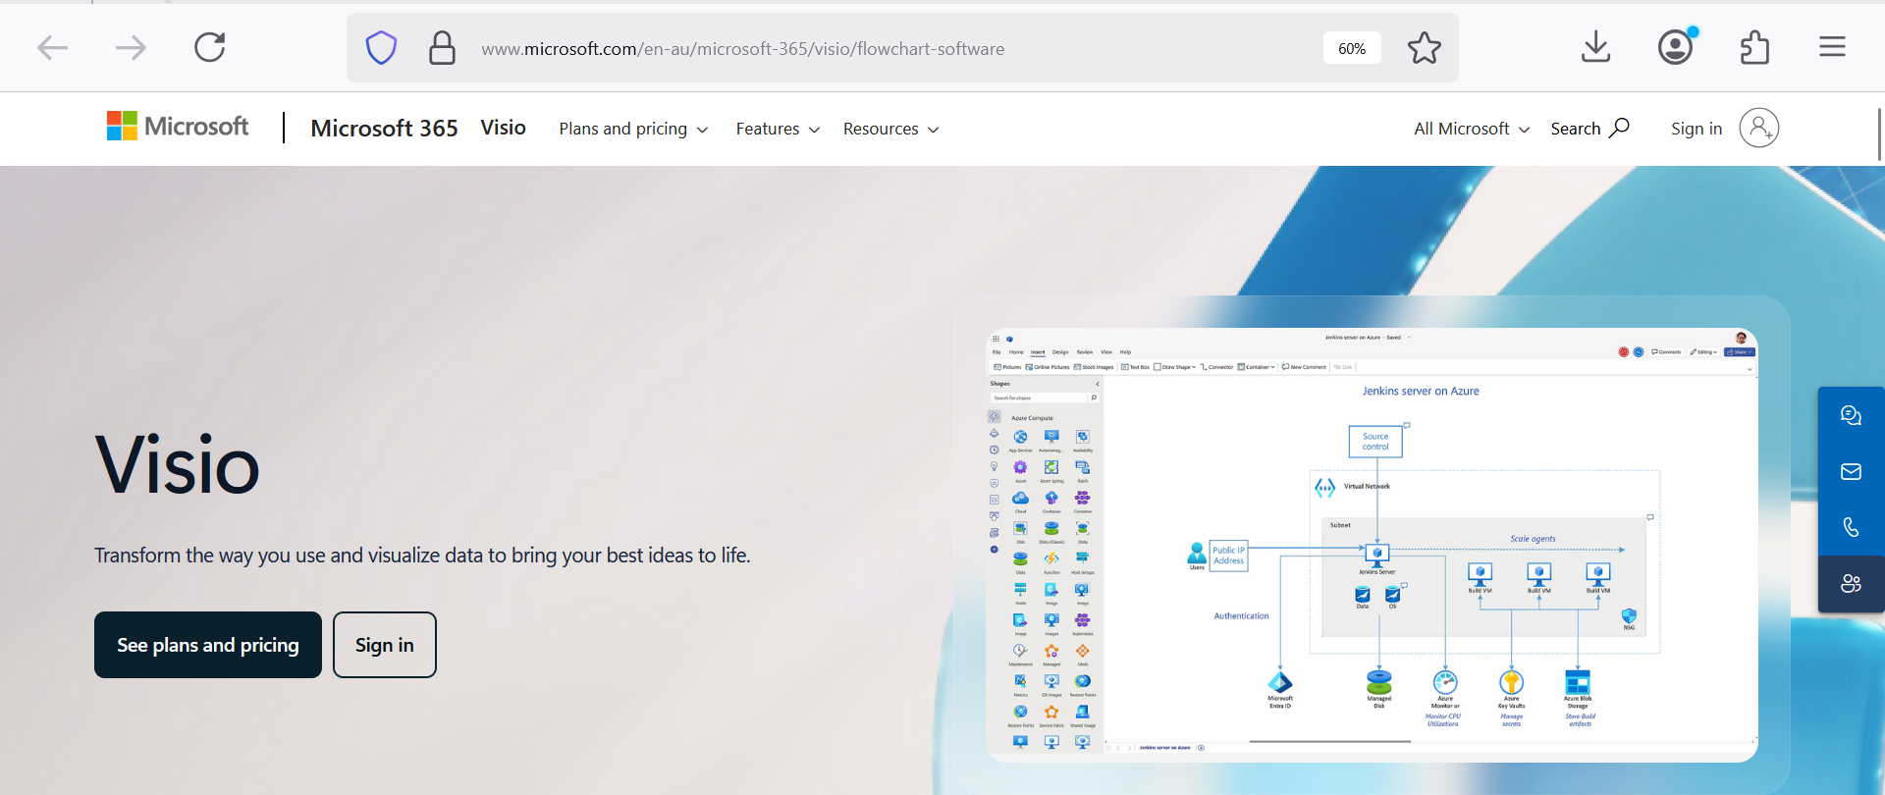
Using Microsoft Visio for UML Diagrams
To download Visio as a standalone app (if not included in your student license):
https://www.microsoft.com/en-au/microsoft-365/visio/flowchart-software
This is the official Microsoft Visio page. Scroll down to compare Visio Plan 1 (web only) and Plan 2 (includes desktop app).

Slide 44
Using Microsoft Visio for UML Diagrams
Tip for Students
Visio Plan 1 is browser-based and lightweight (monthly subscription).
Visio Plan 2 includes the full desktop version and is ideal for UML diagrams and complex modelling tasks.

Slide 45
Overview of UML modelling Tools
In this part, you will learn about the different UML modelling tools, including desktop and online modelling tools. Desktop modelling tools includes StarUML, and the online modelling tools include diagrams.net, creatley.com, and lucid.app. The recommendation for this subject is to use StarUML, which you will also find in another set of resources used to demonstrate different types of UML diagrams.

Slide 46
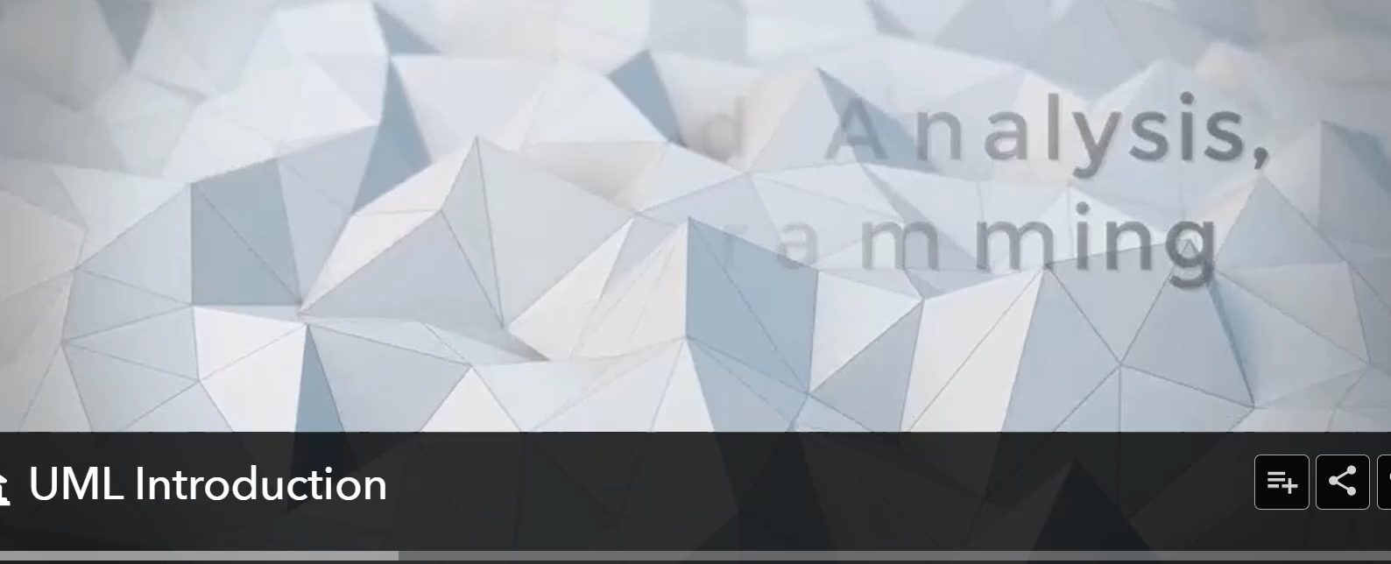
Overview of UML modelling Tools

Slide 47
Week 2 Discussion Questions
How does encapsulation help protect personal info in apps like MyGov or Medicare?
Pick an app you use (e.g. Opal, Commbank). What are some classes and objects in it?
How could inheritance help in building a system for UTS staff, students, and tutors?
What’s an example of polymorphism in a shopping site like Woolworths?
What’s tricky about making a UML diagram for real apps?

Slide 48

Happy Learning and Bright Futures Ahead! Dr. Farshid Keivanian Stay Connected: linkedin.com/in/farshid-keivanian github.com/FarshidKeivanian
Education is the most powerful weapon you can use to change the world. — Nelson Mandela

